Slide 1

PowerPoint 3:
Government in Canada

Slide 2

Governments in Canada
Canada is a federal state, parliamentary democracy and constitutional monarchy.
A federal state brings together a number of different political communities with a central government (federal) for national matters and separate local governments (provincial/territorial) for local affairs.
As a parliamentary democracy, we elect members to our parliament and legislatures across the country.
As a constitutional monarchy, Canada’s head of state is a hereditary sovereign (queen or king), who reigns in accordance with the Constitution.

Slide 3
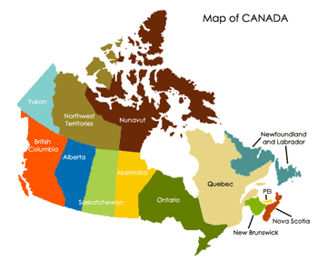
Three Levels of Government
Canada is a very large country with different needs and interests.
In order to meet the needs of citizens, the Canadian government is structured into a three-level system: federal, provincial/territorial and municipal/local.
Each level has its own arrangement of elected and appointed officials as well as a unique set of responsibilities.

Slide 4
Three Branches of Government
Legislative Branch: Creates laws, rules and regulations under federal jurisdiction. The legislative branch is made up of federal elected representatives called Members of Parliament.
Executive Branch: Responsible for government operations, and implementing and enforcing laws and regulations. Includes the Queen’s representative (the governor general) and cabinet ministers (appointed by the prime minister).
Judicial Branch: Interprets the law and determines the penalty for those who violate established laws, rules and regulations. Includes the Canadian court system, which is headed by the Supreme Court and nine appointed judges.

Slide 5
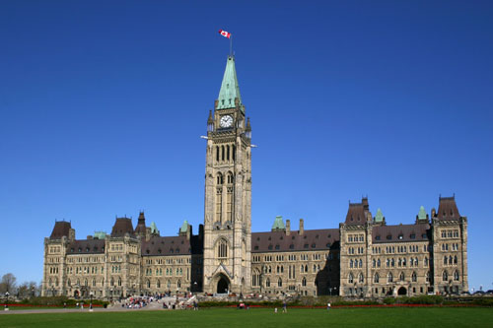
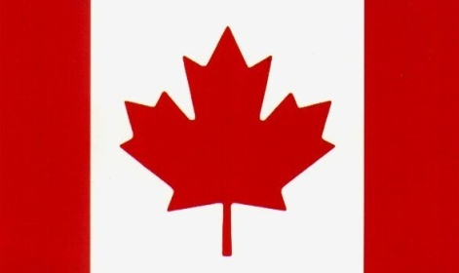
Federal
The elected representative at the federal level is called a Member of Parliament (MP).
Canadians will elect 338 MPs in the current election. This is the federal legislative body, which creates or enacts laws.
MPs debate and pass laws in the House of Commons in Ottawa.
The leader of the government is called the prime minister.
The Queen is represented by the governor general.

Slide 6
Provincial/Territorial
The elected representatives are called Members of the Legislative Assembly (MLAs), Members of Provincial Parliament (MPPs), Members of the National Assembly (MNAs) or Members of the House of Assembly (MHAs), depending on the province or territory.
Elected representatives debate and pass laws at the provincial or territorial legislature.
The leader of the government is called the premier.
The Queen is represented by a lieutenant governor in Canada’s ten provinces and by a territorial commissioner in the three territories.

Slide 7
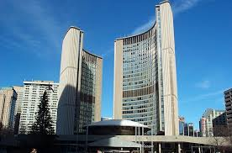
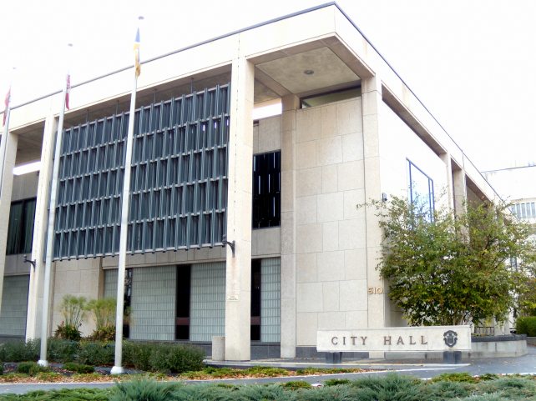
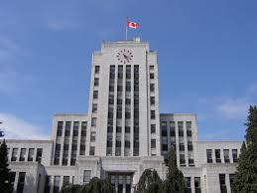
Municipal/Local
The elected representative at the municipal level is called a councillor or alderman.
The head of the council is called a mayor, reeve or chairperson.
The size and structure of the council differs depending on the population it represents.

Slide 8
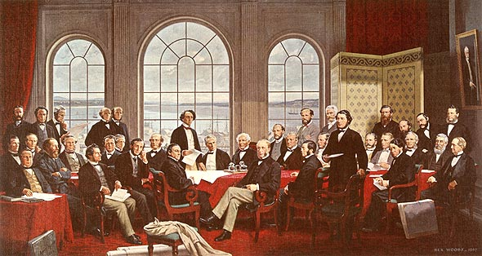
Section 91-95, Constitution
When they chose a federal form of government, the Canadian Fathers of Confederation assigned particular responsibilities to the federal and provincial governments (outlined in Sections 91–95, Constitution Act).
This division of powers is based on the idea of subsidiarity, meaning that the government level closest to the issue governs it.
Municipal/local governments receive powers from their province or territory.

Slide 9
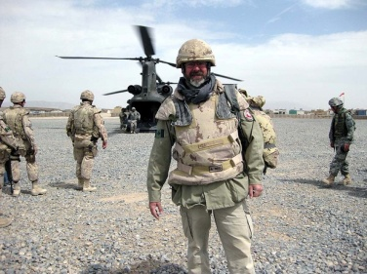
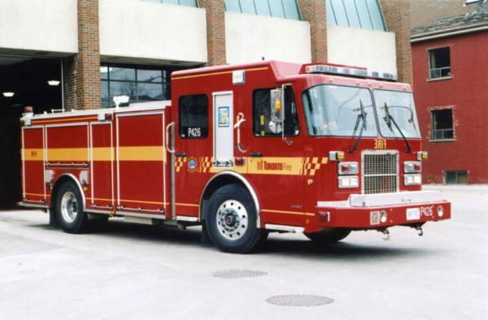

Division of Responsibilities
Federal: Justice, citizenship and immigration, national defence, currency, public safety, fisheries and oceans
Provincial/Territorial: Education, healthcare delivery, environment, energy
Municipal/Local: Road maintenance, water and sewer service, recreation and community facilities, libraries, police protection services

Slide 10
Final Thoughts
Is government important? Why or why not?
How does government affect your life?
Why is it important to know who your elected representative is?

